Slide 1
Introduction to z/OS Security
Lesson 9: Standards and Policies

Slide 2
Objectives
Describe governance, compliance and legal requirements that the business community operates under today
Understand the need for information security guidelines
Understand what system certification and evaluation are and why they are necessary
Explain regulatory acts and their benefits to corporations
Identify the components of an information security program

Slide 3
Key Terms
Compliance
Governance Requirements
Policy
CIPP
CISO
GIAC, CISSP, and SSCP
Sarbanes-Oxley
COSO Framework
CoBIT

Slide 4
Introduction
Implementing security on a system requires a plan.
Creating a plan requires guidelines.
Governments and standards bodies develop laws and guidelines which direct security policies.
Standards and guidelines bring ‘best practices’ to the IT industry.
Standards and guidelines put all IT shops on an even playing field when it comes to auditing and evaluations.

Slide 5
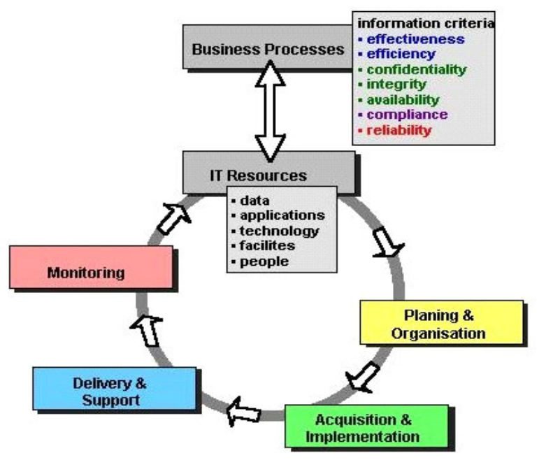
Governance, compliance and legal requirements
Government and professional bodies impose strict control requirements through legislation or certification requirements
Organizations integrate these regulatory controls into their business practices.
It is easier to establish uniform standards and monitor their compliance rather than inspect each company to ensure that it is protecting customer identities and is of the utmost integrity, although governments may check.
Governments and standards boards impose standards or controls only to protect the viability of the corporate environment, consumer privacy and confidence.
The CEO and CISO have to be familiar with the legal requirements and ensure that their organization follows all the laws and implements the procedures necessary.

Slide 6
Regulatory acts
There are two major categories of US laws regulating an organization and its IT operation. The first group covers core business security regulations, such as:
  Basel II, Solvency II, IAS/IFRS, and HIPAA.
The second group includes the regulation of specific business processes related to IT security, such as:
  FISMA, CobIT, British Standard 7799 (ISO 17799), Sarbanes-Oxley Act (US), and Homeland Security Act.
Although most of these acts are originated in the U.S., they already have been or will be adopted in other countries, especially in the European Union.
They apply to all companies acting in the U.S. or being registered at stock exchanges.

Slide 7
Information security guidelines
Essential to managing our information business assets is the creation of the information security program.
Organizations create Critical Infrastructure Protection Programs (CIPP) to protect business-critical infrastructure.
Organizations, mostly in the public sector, have always had such security and control programs and processes with varying degrees of coherence and corresponding effectiveness.

Slide 8
Information security programs
The Executive Information Security Policy, a component of the ISP, defines the scope of the policy and describes the need to protect information infrastructure in general.
Management needs to draft a document defining the program for:
the protection of information infrastructure and assets
the compliance with regulatory requirements
the creation of service level agreements with security included with partners
the creation of Service Level Requirements (SLR) of business unit communications
the creation of the office of the Chief Information Security Officer (CISO) to oversee the program
the update and change of the Corporate Information Security Policy documentation, that includes assigning of specific responsibilities so everyone knows what they are supposed to do and what is expected of them.

Slide 9
System certification and evaluation
Certification involves assessment that all the prescribed measures and controls are in place and that qualified people have technical responsibility for maintaining them.
It is performed independently from the staff who maintain the system.
Certification can be divided into three main areas
  Certification for technical personnel
  Certification for systems
  Certification for processes

Slide 10
Certification for technical personnel
Global Information Assurance Certification (GIAC)
  SysAdmin, Audit, Network, Security (SANS) Institute founded GIAC (Global Information Assurance Certification) in 1999 to develop a technical certification standard for security professionals.
    See the organizational Web site at: http://www.giac.org/
Certified Information Systems Security Professional (CISSP)
  Tests competence in the 10 domains or subject areas and in relevant work experience in the security field.
  CISSPs are most often CISOs or senior level information security managers with policy or senior management responsibilities.
  See the Web site at: http://www.isc2.org
Systems Security Certified Practitioner (SSCP)
  targeted towards the information security technologists that are on the “front-lines”. SSCP are operational technologists who are working as Network Security Engineers, Security Systems Analysts or Administrators.
  The SSCP certification requires proficiency in 7 subject areas.
  See the Web site at: http://www.isc2.org

Slide 11
Certification for systems
Common Criteria
The Common Criteria enables corporate technologists a means of standardizing a common set of requirements for the security functions of IT products.
These standardized requirements are backed by the International Standards Organization (ISO/IEC15408:1999) and are known as the Common Evaluation Methodologies (CEM).
Using CEM we can evaluate between different application and appliances judging how best they address an organization’s security requirements.
In 1999, six countries (Canada, France, Germany, Netherlands, United Kingdom, United States) became signatory to Common Criteria 2.0 making it an international standard.
See the Web site at: http://www.commoncriteriaportal.org

Slide 12
Certification for processes
One challenge companies will face in complying with the regulations is choosing an appropriate methodology and developing a sequence of steps from which to evaluate their internal controls.
Here are two frameworks that are suitable to this task:
  COSO Framework
    This framework describes that internal controls should be comprised of five components and that all components must be in place in order for the internal control to be considered effective.
      Control Environment, Risk Assessment, Control Activities, Information and Communication, Monitoring
  CoBIT: Control Objectives for Information and Technology (CoBIT)
    The objective for creating COBIT was to interpret the COSO Framework specifically from an IT perspective, resulting in a framework that, according to the Information Systems Audit and Control Association (ISACA), is increasingly internationally accepted as good practice for control over information, IT and related risks.’
    In examining COBIT specifically to Sarbanes-Oxley, ITGI has published IT Control Objectives for Sarbanes-Oxley,’ resulting in a framework containing detailed IT processes and control objectives specific to financial reporting.
    Like ISO 17799 the control objectives provide a common framework in what would otherwise require each organization to maintain individualized standards.
  Being able to normalize IT governance standards allows organizations to adopt the best practices gleaned from experience.

Slide 13
Summary
Legislative and corporate governance and compliance requirements required that we create the means by which we manage information security and measure our compliance efforts.
Over the years methods have been developed by the industry and professional associations to ensure that a method existed by which standardized methods and best practices can be shared.
Common Criteria Certification allows consumers to evaluate different products using common guidelines
Personnel, systems, and processes can be certified as compliant with standards

